Slide 1
January 22
Society of Women Engineers

Slide 2
SWE Dues
$5
Reason:
Food for meetings
Outreach event

Slide 3
SWE Points
1 point for events/meetings
2 points for presenting at meetings
3 points for being a national member
5 points for each hour volunteered at outreach event

Slide 4
What SWE Points mean
Bronze 5-10 points
Recognized at End of Year Banquet
Discount T-shirt
Silver 10-20 points
All of above +
Free registration at National or Regional conference
Gold 20+ points
All of above +
Free hotel at a National or Regional Conference

Slide 5
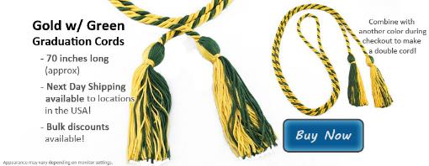
Graduation Cords or Stoles
Cords
$10
Stoles
$30

Slide 6
Outreach Overview
Discovery Club at the Boys and Girls Club of Fayetteville
Group of 8-20 kids age 9-11
Group activity related to science, math or engineering
2 Fridays a month from 3:45pm-5pm
$20 Budget for each Friday
Treats, supplies, etc…

Slide 7
Dates:
Feb 7th :
Feb. 21st :
March 7th:
March 21st
April 4th
April 18th

Slide 8
Outreach Coordinators
Chemical, Industrial, Civil, Biomedical, Mechanical, and Electrical, Biological, Computer
Get a group together for one of the dates
Organize an activity to do for the kids
Great resume builder about being a team leader

Slide 9
Chemical Nominations

Slide 10
Industrial Nominations

Slide 11
Civil Nominations

Slide 12
Biomedical Nominations

Slide 13
Mechanical Nominations

Slide 14
Biological, Computer, Electrical Nominations

Slide 15
Dates with Discipline:
Feb 7th :
Feb. 21st :
March 7th:
March 21st
April 4th
April 18th

Slide 16
SWE Social Event?
Pot luck
Dinner on sundays?

Slide 17
Events Coming Up
Feb 19th – Writing a Cover Letter & LinkedIn Secrets
March 5th – Dr. Pamela Kreeger, a Biomedical Professor from the University of Wisconsin on how she became a professor
April 9th – Alumni Panel Roundtable
April 23rd – SWE End of Year Banquet

Slide 18
Officer 2014-15 Elections
Nominations with picture and short biography by March 14th.
Submit to swe@uark.edu
Voting will take place on April 9th
Must have at least 5 points to run for office
About the positions
President – Plan events, and runs meetings
Vice President – Works with President to plan meetings and runs meetings when President unavailable
Treasurer – Handles applying for funding, bank account management
Secretary – Minutes for officer meetings and regular meetings. Works with Public relations officer to advertise for meetings and reply to emails.
Public Relations – Reserve rooms for meetings, makes and prints flyers for meetings.

Slide 19
Scholarship Page
Grab sheets for your major at the back of the room

Slide 20
Graduation Stoles for sale

