Slide 1
Linked In February 19th
Society of Women Engineers

Slide 2
SWE Dues
$5
Reason:
Food for meetings
Outreach event

Slide 3
SWE Points
1 point for events/meetings
2 points for presenting at meetings
3 points for being a national member
5 points for each hour volunteered at outreach event
EMAIL if you want to know your points

Slide 4
What SWE Points mean
Bronze 5-10 points
Recognized at End of Year Banquet
Discount T-shirt
Silver 10-20 points
All of above +
Free registration at National or Regional conference
Gold 20+ points
All of above +
Free hotel at a National or Regional Conference

Slide 5
Graduation Cords or Stoles
Cords
$10 if not paid dues
Look on our website to order FREE WITH $5 DUES
Order by March 16th

Slide 6
Outreach Overview
Discovery Club at the Boys and Girls Club of Fayetteville
Group of 8-20 kids age 9-11
Group activity related to science, math or engineering
2 Fridays a month from 3:45pm-5pm

Slide 7
Mechanical Nominations
Jessica Montgomery
Kayla S.
Alex S.
Elisabeth Westcott
Amanda Collins

Slide 8
Industrial Feb. 21st
Tori McDaniel
Whitney Gall
Tyler Beneke
Lacey Roberts
Alexa Koenigseder
Savanna Kis
Elisabeth Westcott

Slide 9
Civil - March 7th
Kelley Coakley
Trish Simons
Cardia Rolle
Elisabeth Westcott

Slide 10
Biomedical - March 21st
AJ Boyer and Tayler Pauls
Aundria Eoff
Katie Wilson
Jill Goodrich
Cassie Walker
Elisabeth Westcott

Slide 11
Biological, Computer, Electrical – April 4th
Lexi LaMott and Lauren B.
Anna Irwin
Brenna Blackwell
Betty Phasiri
Elisabeth Westcott
Rachel Findley
Anna Irwin

Slide 12
Chemical – April 18th
Sam Cloud
Marina Lee
Abbie Lasater
Teni Butler
Elisabeth Westcott

Slide 13
Dates with Discipline:
Feb 7th : Mechanical
Feb. 21st :Industrial
March 7th: Civil
March 21^{st:} Biomedical
April 4^{th:} Electrical, Biological, Computer
April 18^{th :} Chemical

Slide 14
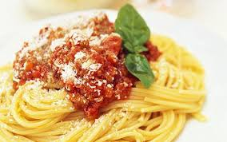
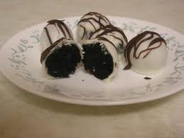
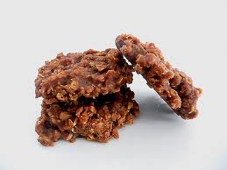
SWE Social Events
Feb 21st Study/Social Potluck 5pm-7pm ENGR 209- look for SWE Uof A facebook page to see who is bringing what ☺
March 14th/15th Friday or Saturday? Movie night at the President’s House with popcorn and snacks
April 18th /19th Baseball Outing playing Vanderbilt Grilled Hot dogs and buns provided.

Slide 15
Fundraising Event
Rick’s bakery goodies
8am-12pm on the top of the ramp of bell
April 14th-17th

Slide 16
Events Coming Up
March 5th 5pm ENGR 209 – Dr. Pamela Kreeger, a Biomedical Professor from the University of Wisconsin on how she became a professor
March 19th 6pm ENGR 209 – Becoming a Leader
April 9th 6pm FEP Lounge– Alumni Panel Roundtable
April 23rd 6pm Union 512 – SWE End of Year Banquet

Slide 17
SWE National Conference
Oct 23rd-26th Los Angeles, CA
Great for getting internships/ networking
If you have an interest please email swe@uark.edu

Slide 18
Officer 2014-15 Elections
Nominations with picture and short biography by March 21st
Submit to swe@uark.edu
Voting will take place on April 2th
Must have at least 5 points to run for office
President must have been a previous officer

Slide 19
Positions
President – Plan events, and runs meetings
Vice President – Works with President to plan meetings and runs meetings when President unavailable, coordinates food for events
Treasurer – Handles applying for funding, bank account management
Secretary – Minutes for officer meetings and regular meetings. Works with Public relations officer to advertise for meetings and reply to emails.
Public Relations – Reserve rooms for meetings, makes and prints flyers for meetings.

