Slide 1
March 19th Meeting
Featuring the CCLC – Leadership Module

Slide 2
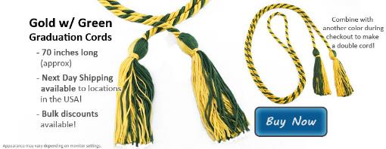
Graduation Cords or Stoles
Cords
$10 if not paid dues
Look on our website to order FREE WITH $5 DUES

Slide 3
Outreach Overview
Discovery Club at the Boys and Girls Club of Fayetteville
Group of 8-20 kids age 9-11
Group activity related to science, math or engineering
2 Fridays a month from 3:45pm-5pm

Slide 4
Biomedical - March 21st
AJ Boyer and Tayler Pauls
Aundria Eoff
Katie Wilson
Jill Goodrich
Cassie Walker
Elisabeth Westcott

Slide 5
Biological, Computer, Electrical – April 4th
Lexi LaMott and Lauren B.
Anna Irwin
Brenna Blackwell
Betty Phasiri
Elisabeth Westcott
Rachel Findley

Slide 6
Chemical – April 18th
Sam Cloud
Marina Lee
Abbie Lasater
Teni Butler
Elisabeth Westcott

Slide 7
SWE Social Events
April 18th 6:05pm @ Baum Stadium Baseball Outing playing Vanderbilt Grilled Hot dogs and buns provided.

Slide 8
Events Coming Up
April 2nd 6pm FEP Lounge– Alumni Panel Roundtable
April 23rd 6pm Union 512 – SWE End of Year Banquet Featuring Dr. Pam Henderson

Slide 9
Fundraising Event- April 14th-17th
Rick’s bakery goodies
8am-12pm on the top of the ramp of Bell
Sign up Sheet

Slide 10
SWE National Conference
Oct 23rd-26th Los Angeles, CA
Great for getting internships/ networking
If you have an interest please email swe@uark.edu

Slide 11
Officer 2014-15 Elections
Nominations with picture and short biography by March 21st
Submit to swe@uark.edu
Voting will take place on April 2th
Must have at least 5 points to run for office and attend March 19th Meeting
President must have been a previous officer

