Slide 1
Dress for success
Society of Women Engineers
September 25th, 2013

Slide 2
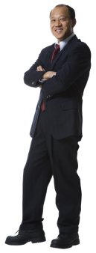
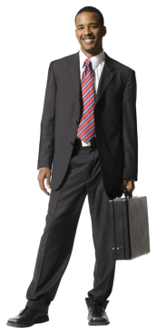
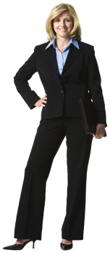
Welcome to DRESS FOR SUCCESS

Slide 3
Shauna bowen
Work Experience
Senior Director—Sam’s Club Innovations ( Sept. 2011-Present)
Director of Innovations—Sam’s Club (Feb. 2010-Aug. 2011)
Senior Manager, International Innovation-Process Engineering—Wal-Mart (Nov. 2009-July 2010)
International Engineering Manager—Wal-Mart (Feb 2008-Nov 2009)
Regional Engineering Manager—Wal-Mart (Feb 2006-Feb 2008)
Industrial Engineer—Wal-Mart (Aug 2004-Feb 2006)
Mechanical Engineer—Teradyne (Jan 2001-Jan 2002)

Slide 4
Dressing in the work place
General Rules
Be conservative (Hair, Clothes, Scent, Jewelry, Finger Nails, Make-Up)
Well Groomed
No gum!
No tattoos, facial piercings
No shorts, jeans

Slide 5
Interview Attire

Slide 6
Interview dress tips
Women
Suits (dark color, knee-length skirts)
Blouses (Solid Colors)
No bare legs (Hosiery, no runs)
Shoes (No open toes, short heels, dressy flats)
No Khakis
Men
Dark Solid Colors
Conservative Tie
2-4 Button Coat (Lean bottom button undone)
Dress Shirt (Solid, Light Color, Long Sleeve, undershirt)
No white socks
Match conservative belt to shoes

Slide 7
Everyday work attire

Slide 8
Formal dinner wear

Slide 9
Dressing on the FLY!

Slide 10
Fall calendar of events
October
2nd—Monthly Meeting: Research Opportunities w/ Dr. Hestekin @ 6pm
9th—What is FREE time? The life of a Co-op
13th—Swing for SWE Golf Tournament
November
6th—Monthly Meeting: Culture, Engineers can experience it . (Study Abroad)
14th—Women in Industry Presented by Black & Veatch Energy @ 5pm
December
4th—Monthly Meeting: Self-Empowerment and Appreciation @ 6pm

Slide 11
Swing for SWE Golf Tournament
Sunday October 13th, at Stonebridge Meadows Golf Course
$75/person
$60/student
Please start advertising and telling your friends about it! Word of mouth is a powerful thing!

Slide 12
Swing for swe golf tournament
Our goal is to attract students, professors, and professionals a like to take part in our golf tournament and turn it into an annual event!
Do you have family members coming in for the Homecoming Football game? Have them play in Swing for SWE the following day!
Fraternity Competition

Slide 13
SWE T-Shirts
$16 each
Don’t forget to pay for your shirts today!
Shirts will be handed out on our October 9th meeting!

Slide 14
Make a difference day
Sign-Up up today to participate in Make a Difference Day for Saturday, October 26th at the Northwest Arkansas Mall
Shifts are from 10 am – 12:30 pm and 12:30 pm – 3:00pm
Bacon Bowl → Benefitting Youth Bridge
Youth Bridge is Northwest Arkansas’ leading provider of comprehensive care to troubled teens and their families. We provide outpatient therapy and counseling, residential substance abuse treatment, emergency shelters, academic and social support, a therapeutic group home for teens involved in the juvenile justice system and a transitional living program for homeless young adults. Each year Youth Bridge serves more than a thousand teens and their families from an eight-county area in Northwest and North Central Arkansas.

Slide 15
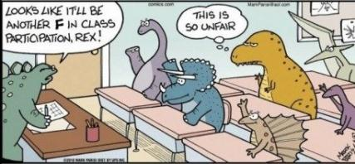
How to get points-Meetings/Membership
10 points for being a national member of the Society of Women Engineers
1 point for each meeting you attend
2 points for participation in a meeting (being a model in the Dress for Success event, talking about an experience like study abroad research or job)

Slide 16
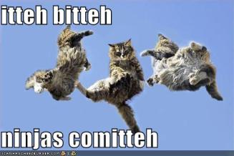
How to get points-Outreach/Fundraising
5 points for getting donor/ sponsorship for the golf Tournament.
5 points for active participation in a committee.
3 points for each volunteer opportunity you participate in even if it is not associated with SWE (If more than 2hours long, 1 point for each hour +3 points for volunteering)

Slide 17
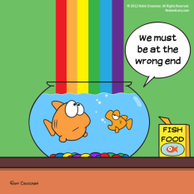
Level of Participation
Bronze - 10-20 points
Recognized at End of Year Banquet
Silver – 20-30 points
Recognized at End of Year Banquet
Eligible for reduced rate for any T-Shirt
Gold – 30-40 points
Recognized at End of Year Banquet
Eligible for Free Conference Registration at Nationals

Slide 18
Black & VEATCH SPEAKER
A speaker from Black & Veatch Energy will be coming to talk to our chapter about what the company does, as well as the role women play in industry
Majority availability: Afternoon or Evening?
What do you want her to discuss during her presentation? What do you want out this event?

Slide 19
closing
Thank you for coming Dress for Success!
We hope to see you all at our Monthly Meeting next week, on October 2nd at 6:00 pm in ENGR 209 where Dr. Hestekin will be discussing Research and REUs
Keep advertising for Swing for SWE!
Join our UA SWE SECTION Group on Facebook for meeting and event updates!

Slide 20
acknowledgements
A huge thanks goes out to our beautiful models Kelley and Elisabeth, and also to our handsome models Addison, Chris, and Tyler
Let’s give a big round of applause to Shauna Bowen for volunteering her time in order to prepare us for a successful future in industry!

