Slide 1
And now for something completely different…
Jamie Hestekin
University of Arkansas
www.comp.uark.edu/~jhesteki
Dr. Carrier has offered to give everyone in your group of 4 an “A” if you can win this scenario, figuring you realistically have no chance. He is places 4 boxes in a room with each of your 4 names under one of the boxes (one name per box). You are to enter the room, pick 2 boxes, and then if pick your name with one of your two choices you walk out the other side of the room. He then comes in and replaces the boxes with all 4 names in the same place and the next person comes in and does the same thing. If you all 4 of you are able to correctly pick your name, you get an A. Otherwise, you all have to do the work. He provides you one advantage…you can talk strategy ahead of time. However, you can have no contact once the picking starts.
What are the odds of getting an A by random guess scenario?
What are the odds of getting an A by the best strategy you can use (no cheating)?
What is that strategy?

Slide 2
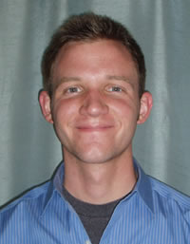
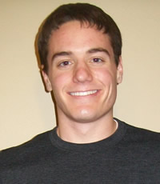
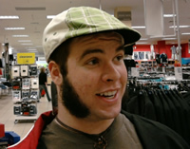
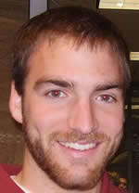
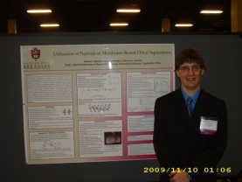
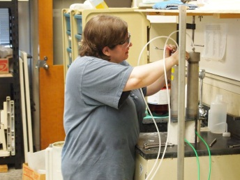
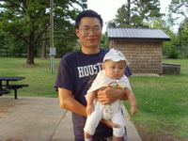
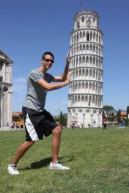
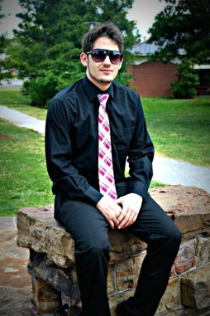
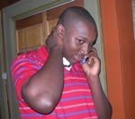
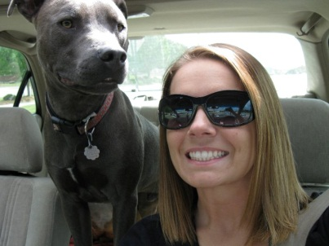
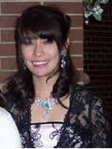
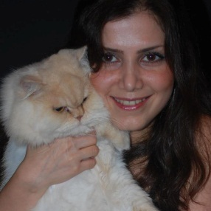
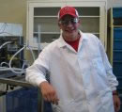
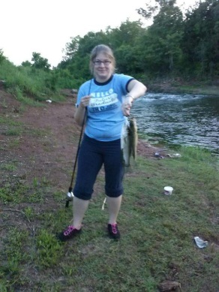
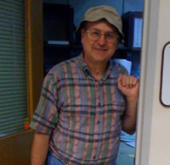
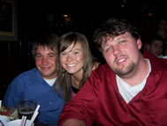
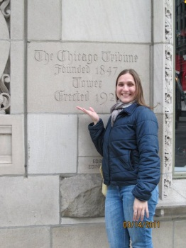
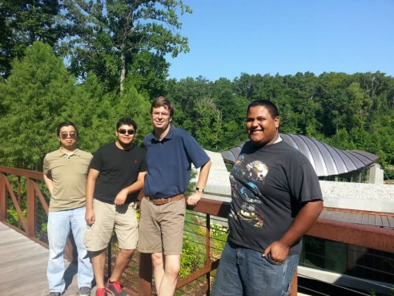
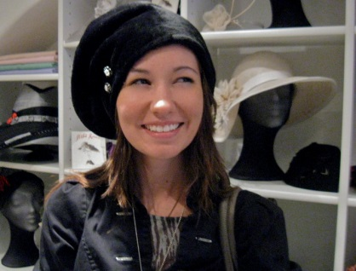
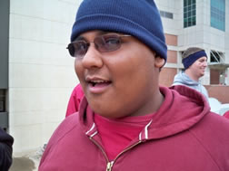

Slide 6
Research
Why do undergraduate research?
GREAT THING on your resume
GREAT for getting good letters of recommendation
GREAT for getting a chance to publish a paper
GREAT job (flexible)
GREAT chance to find out if you want to go to graduate school
GREAT opportunity for travel
How do I do undergraduate research?
SURF\Honors Grant (talk about soon)
Class Credit
Work Study
Hourly pay as part of grant

Slide 7
What is a SURF and an REU?
What is a SURF?
State Undergraduate Research Fund, competitive grant.
Work with a professor, get money.
Training session October 4 and October 10
I find out about it…. http://honorscollege.uark.edu/98.php
How do I do a SURF? http://honorscollege.uark.edu/232.php
When are the deadlines?
http://honorscollege.uark.edu/183.php
If you want to do this in the fall, the time is now!
What is an REU?
A summer research experience
You get paid
You get experience.
Great way to decide if you want to go to a school.

Slide 8
How do I approach a professor about research?
Good
Knock on their doors and ask them to talk.
Better
Set up an appointment and have looked at their website.
Best
Set up an appointment via email, look at their website, have read one of their papers, and ask a question about it.
Tell them
I want to do research
Whether or not you are interested in further school
Bring a resume
Be enthusiastic
Tell them you don’t know exactly what you want to do

Slide 9
Writing the SURF grant
5 pages…not that hard, but takes time.
Has to be written by you.
Your professor will help you with idea and general structure.
Longest lead time is your letters!

Slide 10
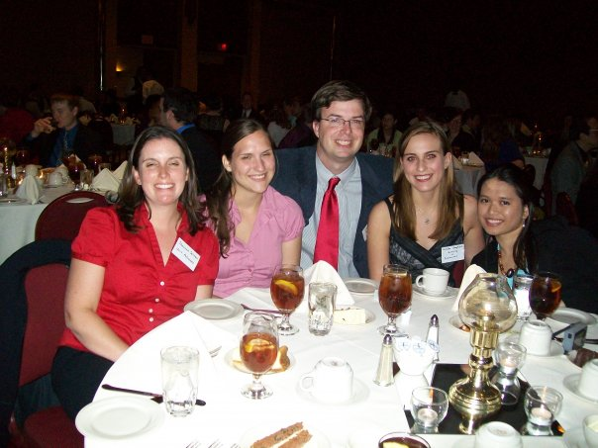
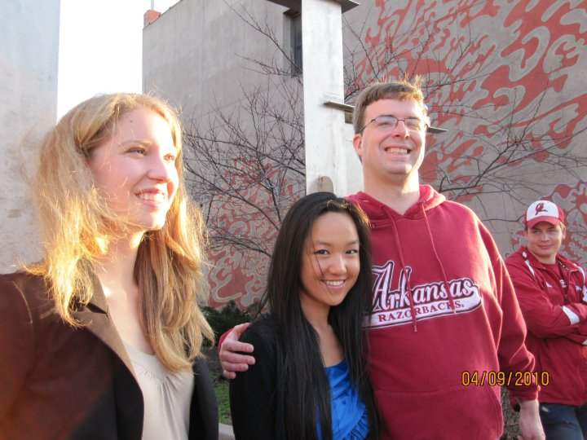
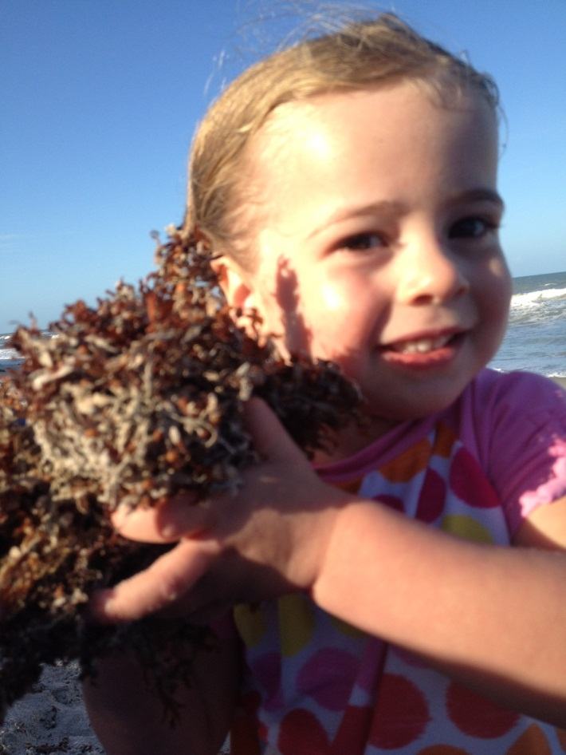
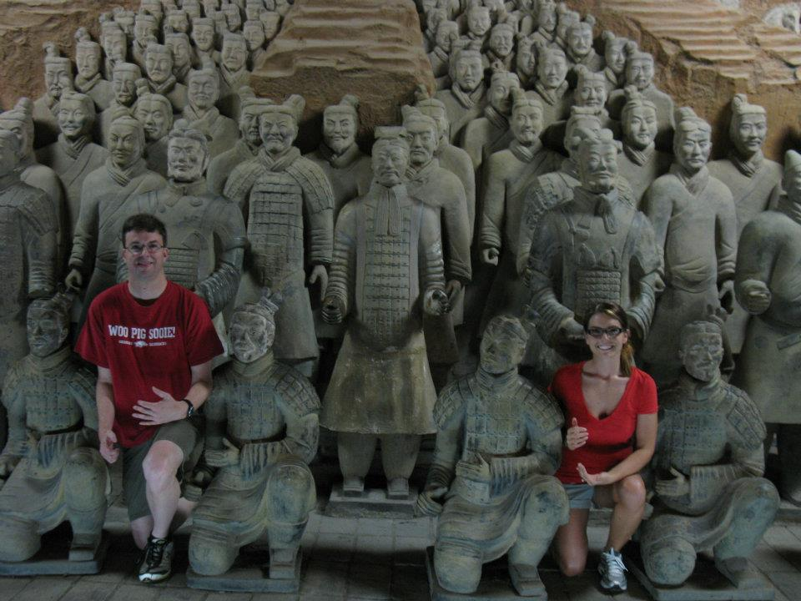
Any questions?
1/16
10/24
????

