Slide 1
Swe september meeting
Society of Women Engineers
September 4th, 2013

Slide 2
Mums the word
Line yourselves up in order of birthdate—without talking!
You have 3 minutes. . . GO!

Slide 3
Cheesy ice breaker
Find your match!
You have been given a popsicle stick with a word, person, or phrase. Someone has your “match.”
For example: “Salt” will be matched with “Pepper”

Slide 4
What exactly is swe?
The Society of Women Engineers’ mission is to stimulate women to achieve full potential in careers as engineers and leaders, expand the image of the engineering profession as a positive force in improving the quality of life, and demonstrate the value of diversity.
At the U of A, we hope to spark interest of math and science in adolescent girls through after-school programs

Slide 5
Why become a swe member?
A strong network of women engineers from academia, government and industry, corporate representatives, government officials, and other individuals supporting and advocating for the mission of SWE.
Scholarship opportunities for all educational and professional levels, including undergraduate and graduate students, and women re-entering the workforce as engineers (at national and section levels).

Slide 6
Why become a swe member?
Collegiate to Career Membership
One time payment of $50 for all collegiate years through the first year of professional grade employment
Collegiate
College students membership for $20 (must be renewed every year)
Go to societyofwomenengineers.swe.org to get your SWE membership

Slide 7
WHY become A swe member?
Anne Maureen Whitney Barrow Memorial Scholarship
All Engineering
Freshman, Sophomore, Junior, and Senior eligible
1 @ $7,000 renewable for 5 years
Susan Miszkowicz Memorial Scholarship
All Engineering
Sophomore, Junior or Senior eligible
1@ $1,500
Meredith Thoms Memorial Scholarships
All Engineering
Sophomore, Junior, Senior eligible
5 @$2,400

Slide 8
Why become a swe member?
Dorthy Lemke Howarth Memorial Scholarship
All Engineering
Sophomore Eligible
6 @$3,000
B. J. Harrod Scholarship
All Engineering
Freshman eligible
2 @ $1,500
MASWE Memorial Scholarship
All Engineering
Sophomore, Junior, Senior
4 @ $1,500

Slide 9
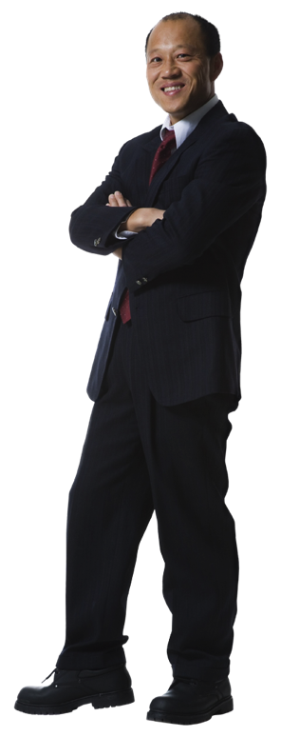
DRESS FOR SUCCESS
Thursday, September 25th @ 6pm in BELL 2286
At this event, we have a professional woman whom works in industry, telling us the dos and don’ts of fashion in the workplace. This event is a fun and visual way to see what is appropriate for interviews, business dinners, everyday work-casual, and business formal wear. Snacks will be available during the event.

Slide 10
Fall calendar of events
October
2nd—Monthly Meeting: Research Opportunities w/ Dr. Hestekin @ 6pm
9th—Honors College Talk/Resume Building @ 6pm
13th—Swing for SWE Golf Tournament
November
6th—Monthly Meeting: Co-Ops @ 6pm
14th—Women in Industry Presented by Black & Veatch Energy @ 5pm
December
4th—Monthly Meeting: Self-Empowerment and Appreciation @ 6pm

Slide 11
Swing for SWE Golf Tournament
Fall Fundraiser
Sunday October 13th, at Stonebridge Meadows Golf Course
$75/person or $60/student
Prizes given to 1st,2nd,3rd, longest drive, and closest to the hole

Slide 12
Swing for swe golf tournament
WE NEED COMMITTEES TO MAKE THIS HAPPEN!
Prize Committee
Advertising Committee
Food/Snack Committee
Our goal is to attract students, professors, and professionals a like to take part in our golf tournament and turn it into an annual event!

Slide 13
brainstorming
Break up into small groups and discuss what businesses to approach for potential golf tournament players

Slide 14
2013-2014 SWE T-Shirts
$16 each
Order your t-shirt today!
The t-shirts will be passed out at our next Monthly Meeting (October 2nd)

Slide 15
closing
Thank you for coming to our first monthly meeting!
We hope to see you all September 25th at Dress for Success
If you signed up for a Golf Tournament Committee, look out for e-mails informing you when Committees will be meeting! We have a mere month and a half to plan accordingly!
Join our UA SWE SECTION Group on Facebook for meeting and event updates

